Slide 1

PYTHON · LANGGRAPH · SERPAPI · PANDAS
Agentic SEO Ranking System

Slide 2
Table of contents
3
Project Overview
4
Problem Statement
5
Solution Approach
6
Agentic Architecture (LangGraph)
7
Google Places Ranking Logic
8
Google Search Ranking Logic
9
Results & Key Learnings

Slide 3
PROJECT OVERVIEW
The Agentic SEO Rank Analyzer is an automated system designed to determine:
Google Places (Local) ranking
Google Organic Search ranking
for a website across multiple keywords using an agent-based execution flow.
The system dynamically adapts to Google’s ranking behavior instead of relying on fixed scraping logic.

Slide 4
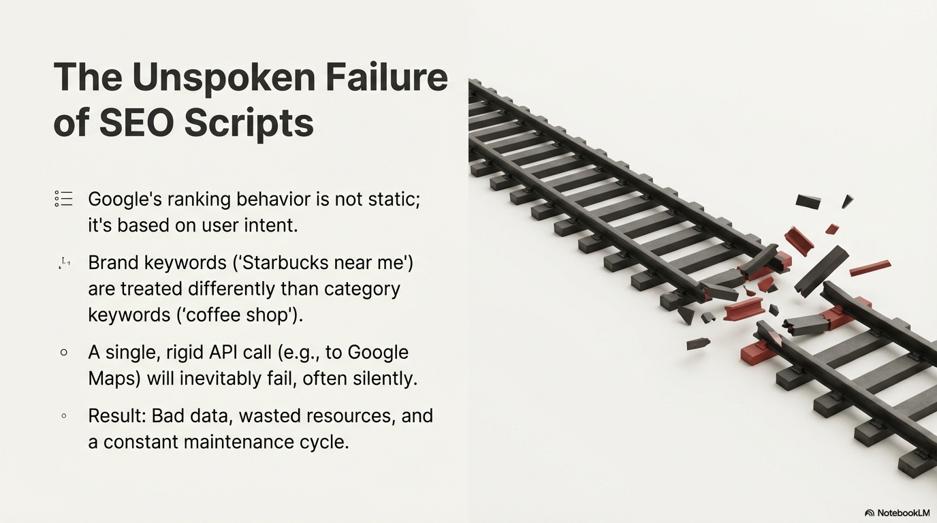

Slide 5
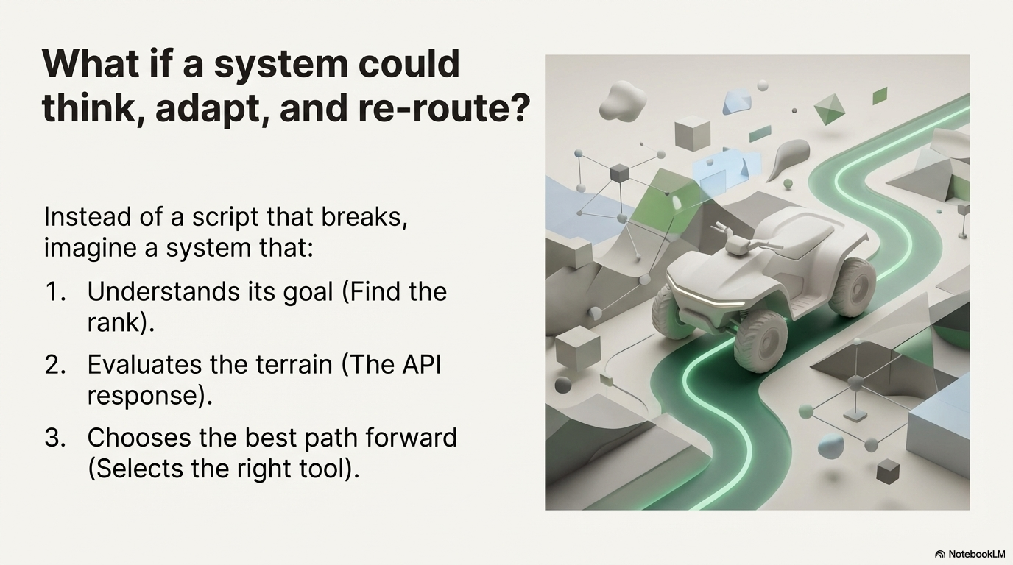

Slide 6
PROBLEM STATEMENT
Traditional keyword ranking scripts fail because:
Google Places does not return results for all keywords
Brand and category keywords behave differently
Google Maps and Local Finder are separate systems
Rigid logic results in incorrect “NA” rankings
Hence, an adaptive and intelligent ranking system is required.

Slide 7
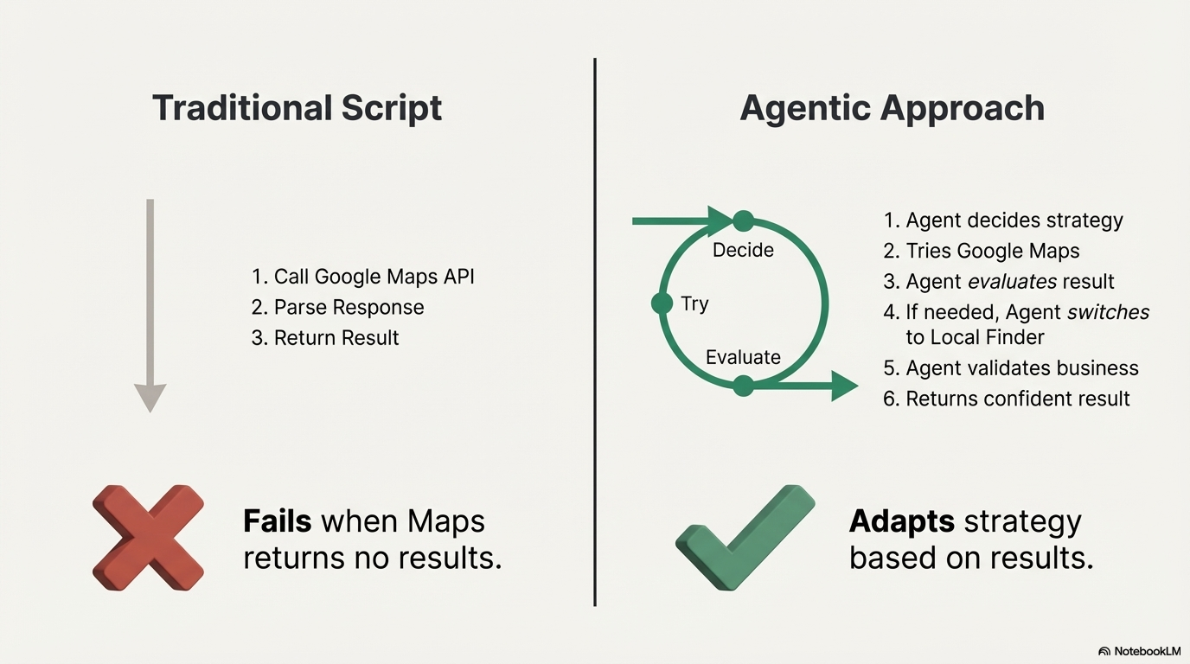

Slide 8
SOLUTION APPROACH
The solution uses a hybrid ranking strategy:
Google Maps → for strong local discovery keywords
Google Local Finder → for weak or mixed local intent
Google Search → for organic website ranking
This ensures accurate ranking detection for all keyword types.

Slide 9
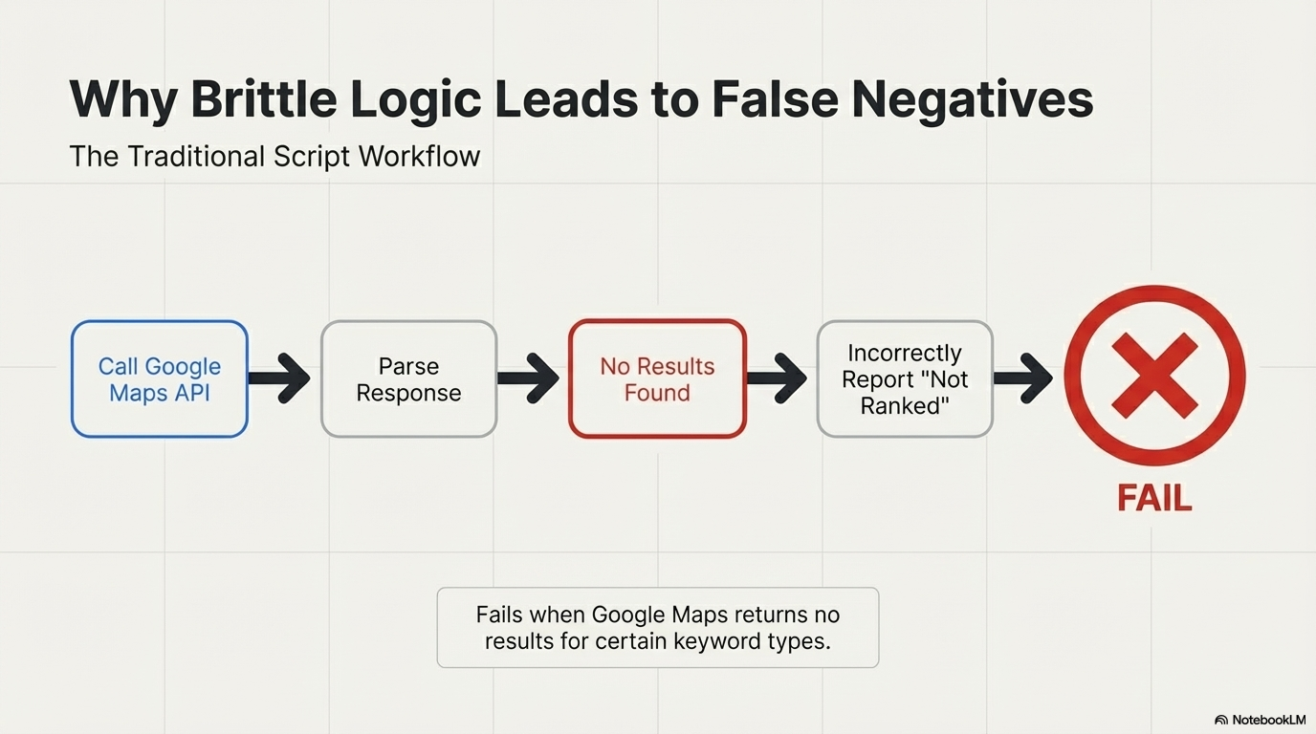

Slide 10
AGENTIC ARCHITECTURE
The system is implemented using LangGraph with modular agents:
Places Rank Agent
Search Rank Agent
Each agent:
Performs a single responsibility
Shares state through LangGraph
Executes in a controlled, deterministic workflow
This design improves scalability and maintainability.

Slide 11
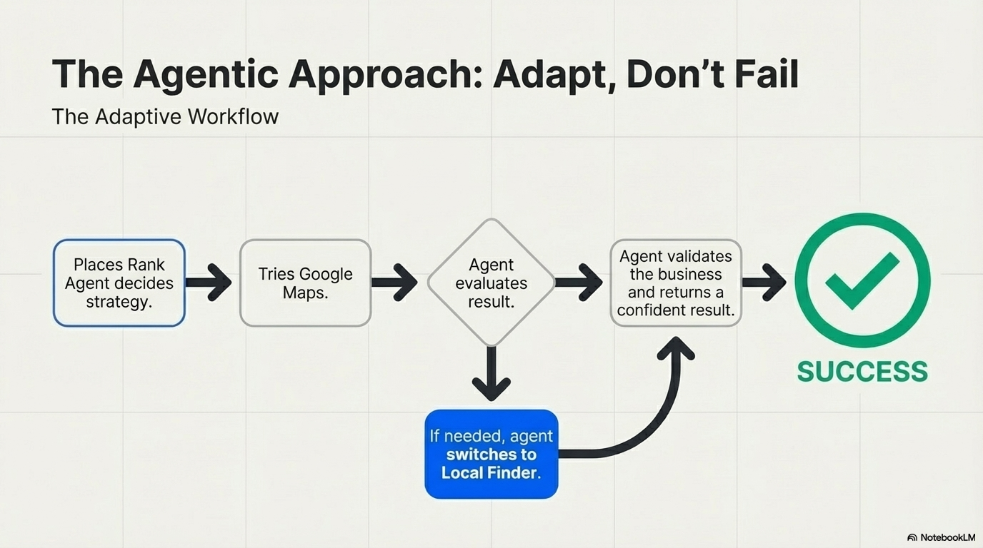

Slide 12
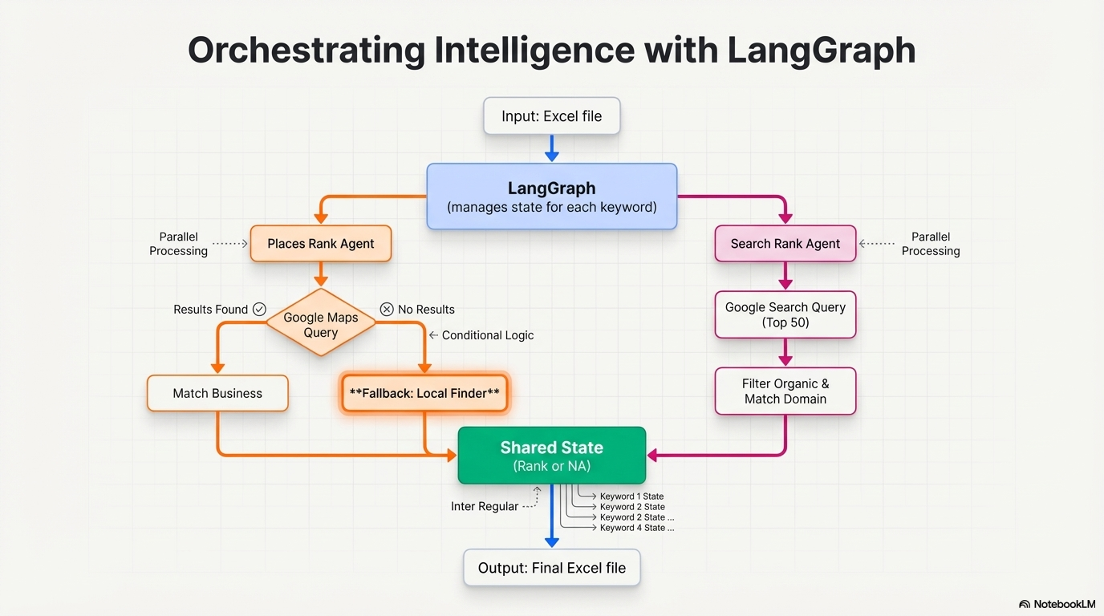

Slide 13
GOOGLE PLACES RANKING LOGIC
Hybrid Google Places Logic:
Query Google Maps
If no results → fallback to Local Finder
Match business using:
Business name
Website domain
This approach reflects real Google Places behavior and avoids false NA results.

Slide 14
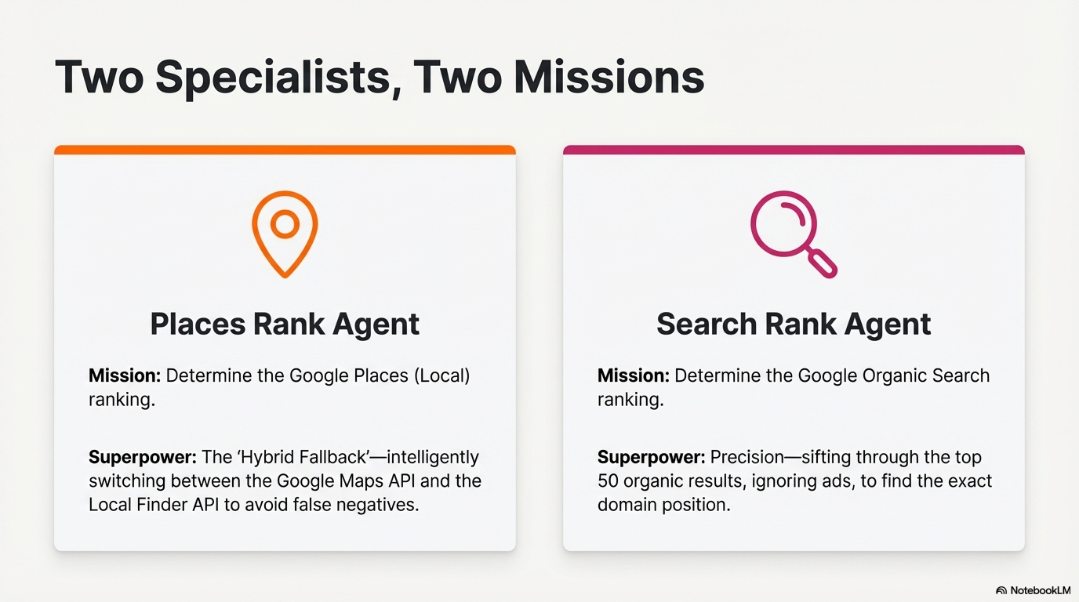

Slide 15
GOOGLE SEARCH RANKING LOGIC
Fetches up to top 50 organic results
Ignores ads and sponsored links
Matches website domain
Returns exact rank or NA
This logic is independent and does not interfere with Google Places ranking.

Slide 16
RESULTS & KEY LEARNINGS
This project demonstrates how Agentic AI systems can solve real-world SEO challenges by:
Making intelligent decisions
Brand keywords rank higher in Places
Category keywords show varied rankings
Not all keywords trigger Google Maps results
Hybrid fallback logic ensures accuracy
Key Learning:
Google ranking is intent-based, not static.

Slide 17
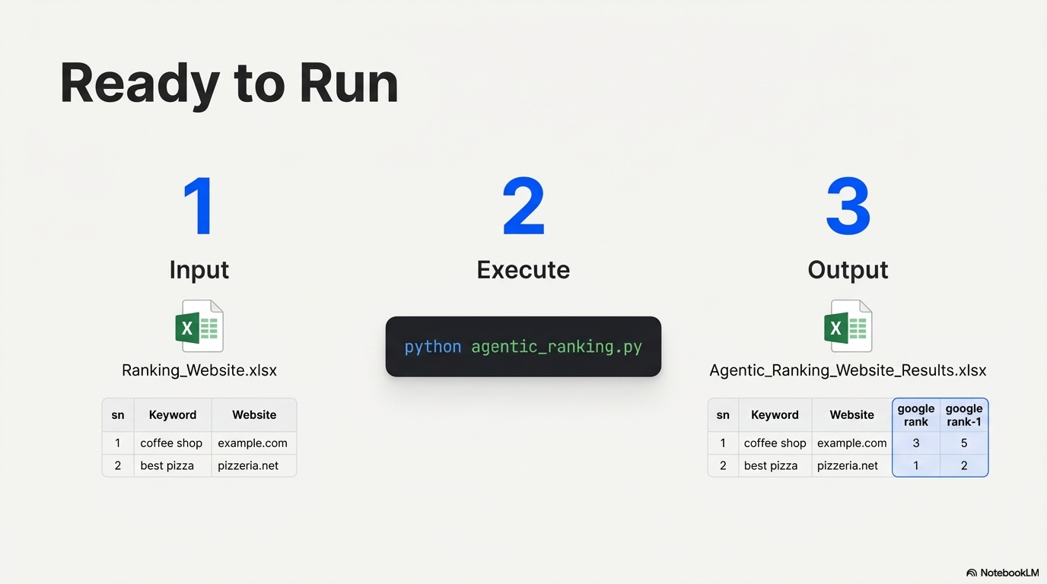

Slide 18
Thank you
BY - HARSHIT WALDIA

